Slide 1

Project Presentation
H1B Case Status Analysis
MIS 749 Spring 2018
Stats Whispers
Team Member : Deepika Siriah, Ketul Patel, Rashmi Sawant, Shraddha Masuti
Notes:
Introduction: About cloud

Slide 2

Project Overview
Subject: H1B case status analysis
(Data source: H1B Disclosure data
Dataset :United States Department of Labor)
Purpose: Analyze the data, predict case status for H1B visa and
determine the predictors influencing the prediction.

Slide 3
Agenda
Approach
Models
Main Findings
Recommendation

Slide 4
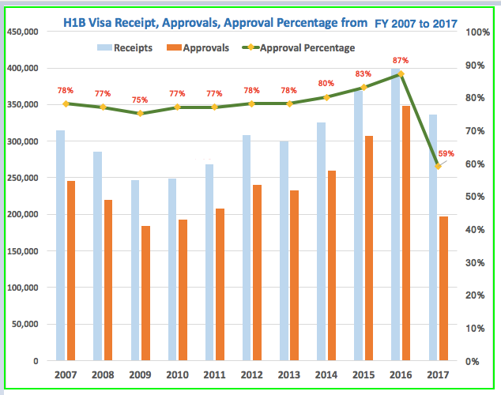
Approval Percentage of H1B visa
Source : Redbus2US.com

Slide 5
Hypothesis
Null Hypothesis: There is a stratified randomness and hence there is a relationship between the predictors and case status
Alternative Hypothesis: There is no stratified randomness and hence there is no relationship between the predictors and case status

Slide 6
Project Goals
Identify the possible predictors of H1B case status.
Predict H1B case status and find Inference
Identify the best predictive model for determining the H1B case status.

Slide 7
First Look at the Data
Raw Data
Number of rows - 610304
Number of columns - 52
With 4 class in the response variable - Certified, Denied, Certified Withdrawn, Withdrawn
Columns had unique values and many factor levels
Case Number, Employer Name, Job Title
Columns had a preponderance of missing values
Original_cert_date, Public_disclosure_location
Response variable for the project
Certified, Denied

Slide 8
Grooming the Data
Removed Predictors
Irrelevant/Non predictive value
Missing value
Duplicates
Unique factor levels
Correlated to Response variable
Final number of predictors
Categorical – 24 predictors
Numeric (Dummy coded) – 71 predictors
Final number of rows
Due to computational complexity we selected subset of our data
Number of rows – 136, 674

Slide 9
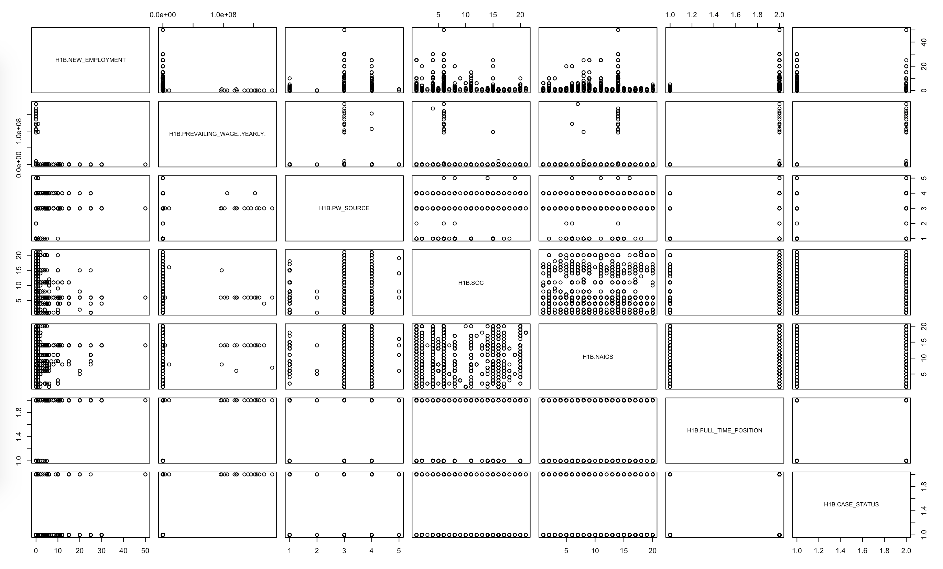
Data Exploration

Slide 10
Model Planning
70/30 split between training data and test data
10 folds cross validation
Class Imbalance
Techniques tried for balancing the data
ROSE
Ovun.Sample
Upsample
SMOTE
Train Data | Test Data
95672 | 41002
Certified | Denied
94549 | 1123
FINAL CLASS BALANCE USING SMOTE
Certified | Denied
57273 | 57273

Slide 11
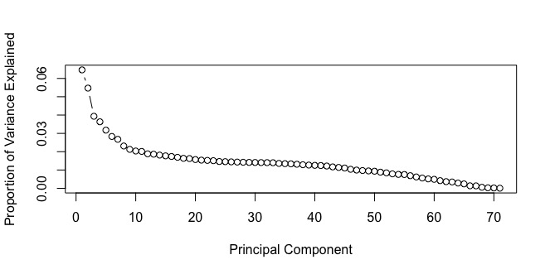
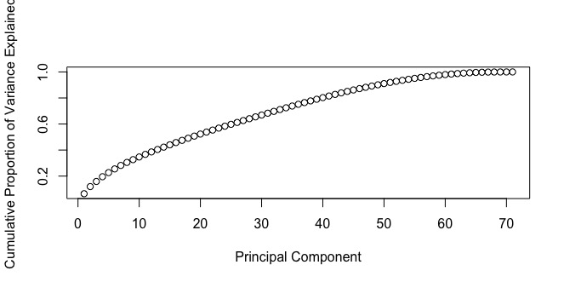
Principal Component Analysis

Slide 12
Modelling
Logistic Regression (GLM)
Linear Discriminate Analysis (LDA)
Decision Tree
Naïve Bayes
Random Forest
Bagging
Boosting
Generalized Additive Model (GAM)
Partial Least Square (PLS)

Slide 13
Variable Importance
 | GLM | LDA | DT | Naïve Bayes | PLS | Glmnet | Random Forest | Bagging without PCA
1 | PW_WAGE_LEVEL | NEW_EMPLOYMENT | AMENDED_PETITION | NEW_EMPLOYMENT | H1B_DEPENDENT | SOC | NEW_EMPLOYMENT | AMENDED_PETITION
2 | FULL_TIME_POSITIONY | SOC. | NEW_EMPLOYMENT | WAGE_RATE_OF_PAY_FROM | SUPPORT_H1B | PW_SOURCE | AMENDED_PETITION | NEW_EMPLOYMENT
3 | AGENT_REPRESENTING_EMPLOYERY | H1B_DEPENDENT | PW_SOURCE | PW_SOURCE | NEW_EMPLOYMENT | H1B_DEPENDENT | CHANGE_EMPLOYER | CHANGE_EMPLOYER
4 | SOC | SUPPORT_H1B | CHANGE_EMPLOYER | PREVAILING_WAGE | SOC | NAICS | CONTINUED_EMPLOYMENT | PW_SOURCE
5 | NEW_EMPLOYMENT | PW_SOURCE | SOC | AGENT_REPRESENTING_EMPLOYER | PW_SOURCE | WILLFUL_VIOLATOR | NAICS | SOC

Slide 14
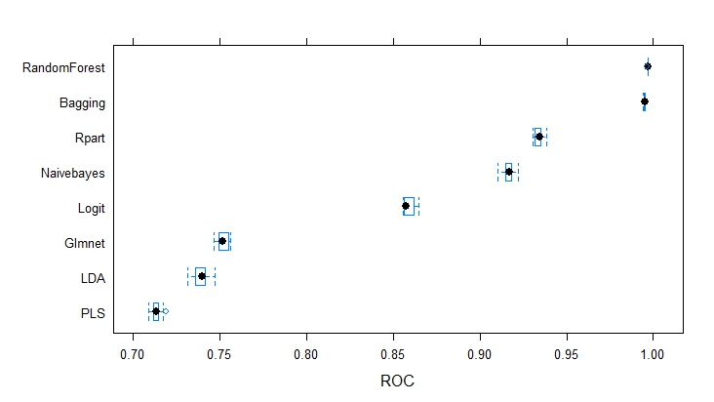
Train Performance without PCA

Slide 15
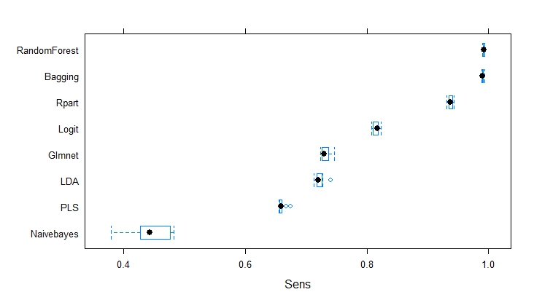
Train Performance without PCA

Slide 16
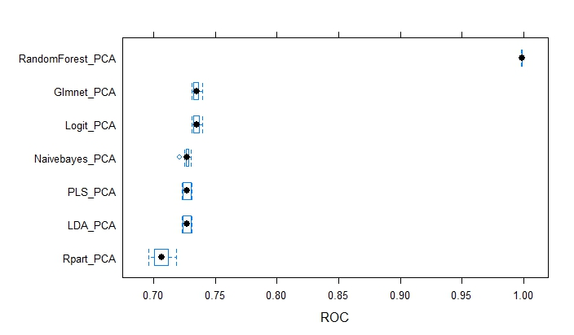
Train Performance with PCA

Slide 17
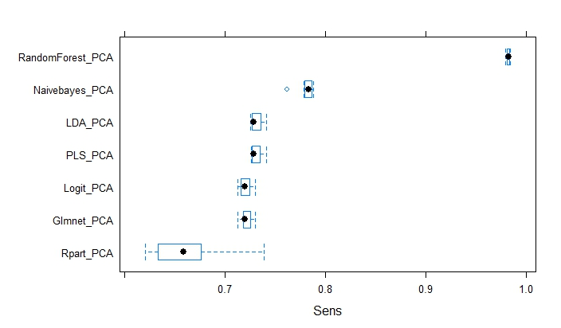
Train Performance with PCA

Slide 18
Comparison Models without PCA

Slide 19
Comparison Models with PCA

Slide 20
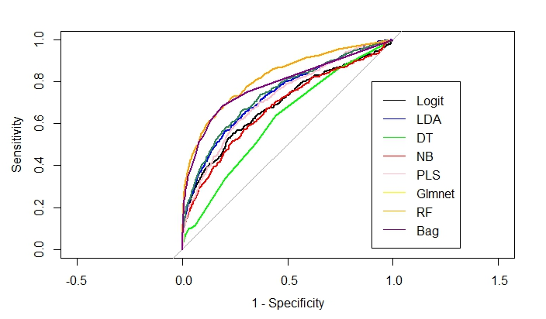
Final Model Selection

Slide 21
Final Model Selection

Slide 22
Random Forest without PCA
CONFUSION MATRIX
 |  | ACTUAL
PREDICTION |  | CERTIFIED | DENIED
 | CERTIFIED | 35936 | 195
 | DENIED | 4585 | 286

Slide 23
Future Scope
Black box models like SVM, neural network
Modeling with predictors that has many unique factors
eg : job title and employer name.

Slide 24
Recommendations
Understanding the important factors affecting the H1B case status will help to
Reduce risk of sponsoring wrong candidate
Help in investment on right candidate
Choosing right candidate will help to speed up the process of applications
Run the model on test sample dataset before deploying in the production environment to understand the initial performance.
The model will be used only once in the year, but run the model quarterly to get precise results.
The model is scalable for any future scope expansion.
Notes:
Results are % accuracy
Important factors
Our model helps to understand the variables that affects the H1B case status, this would reduce the risk of choosing the wrong candidate.
Save investment on sponsoring the wrong candidate

Slide 25
Q&A
Notes:
Results are % accuracy
Important factors
Our model helps to understand the variables that affects the H1B case status, this would reduce the risk of choosing the wrong candidate.
Save investment on sponsoring the wrong candidate

